Slide 1
Vision Diagrams Series Insider Risk Management
Thierry Matusiak - Data Protection & Compliance - Technical Specialist
Version : 2022-05-31

Slide 2
Insider Risk Management
monitors internal users activity
to identify suspicious behaviors
Insider Risk Management – Definition

Slide 3
Insider Risk Management – Summary

Slide 4
Insider Risk Management – More Details

Slide 5
Insider Risk Management – Even More Details

Slide 6
Vision Diagrams Series Insider Risk Management
Thierry Matusiak - Data Protection & Compliance - Technical Specialist

Slide 7

Conclusion

Slide 8


Slide 9
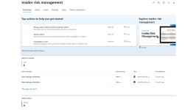
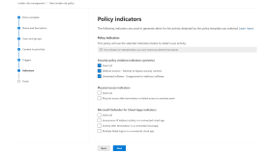
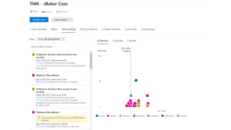
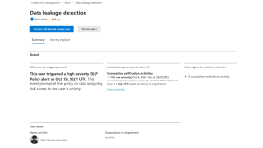
Insider Risk Management – Summary

Slide 10
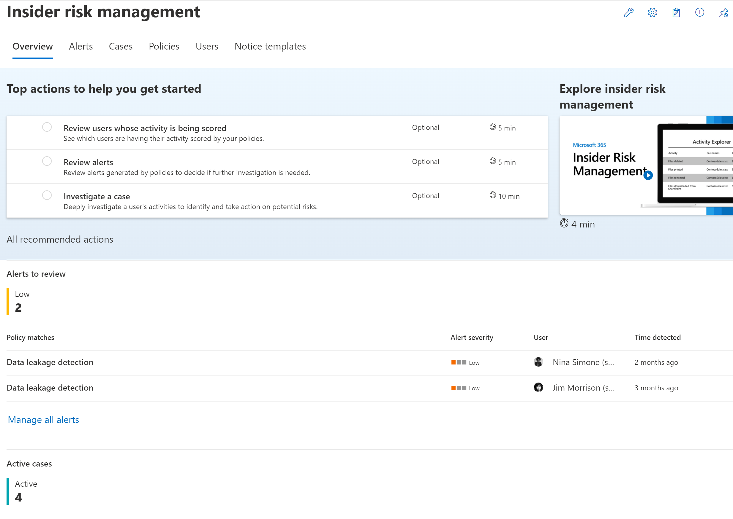

Slide 11
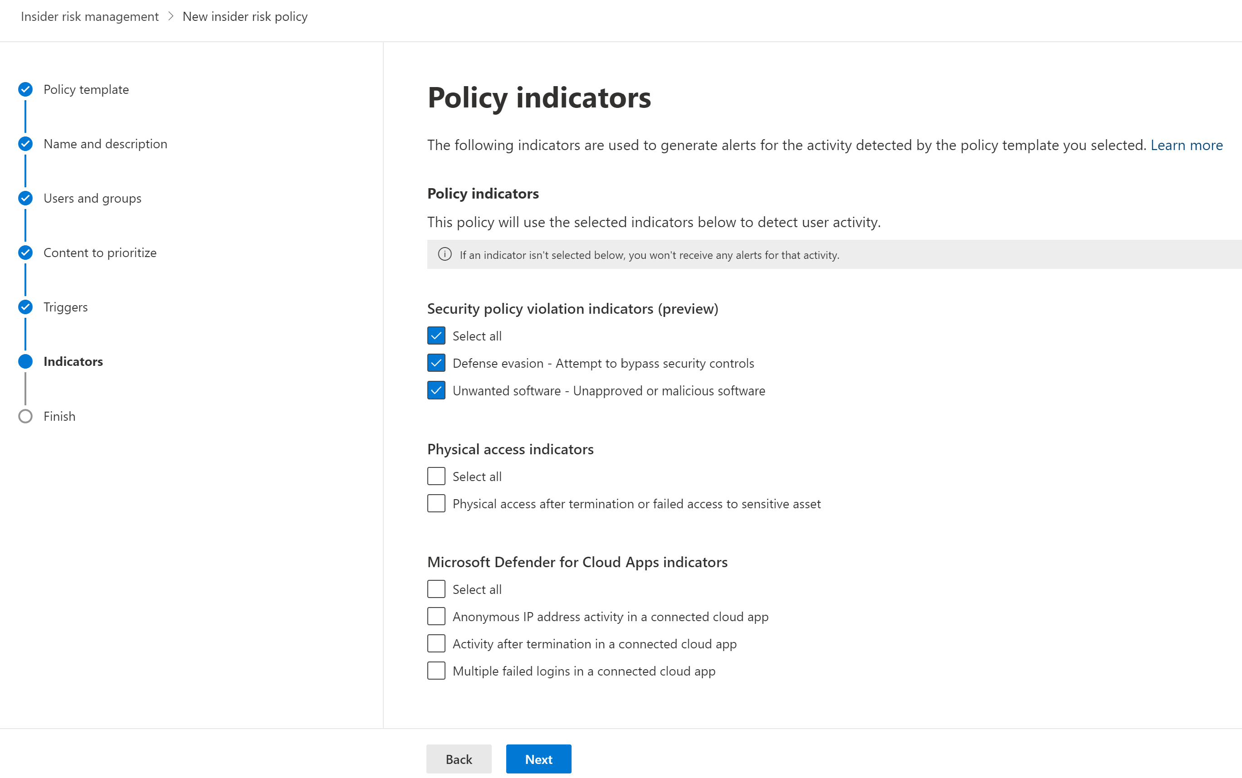

Slide 12
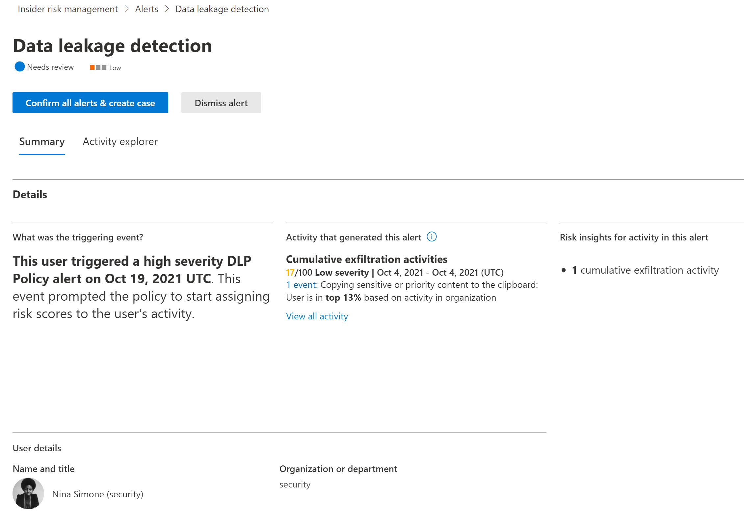

Slide 13
